Slide 1

CSCI 466: Networks
Wireless Networks, WiFi, Cellular Networks (4G/5G)
Reese Pearsall Fall 2022
https://www.cs.montana.edu/pearsall/classes/fall2022/466/main.html
*All images are stolen from the internet
1

Slide 2
Announcements
PA3 Due Friday @ 11:59 PM
HW4 Posted, due Friday December 9th @ 11:59 PM
Final Exam Study Guide Posted

Slide 3
Intrusion Detection System
An instruction detection system (IDS) will generate an alert when potentially malicious traffic is observed
Two types –
1. Signature-Based Detection Systems
Maintain a large database of known “signatures” for malicious packets
-- Malicious IP addresses or URLs -- Email Addresses
-- Specific String of Bits -- File/Message Hashes
-- Protocol Specific (nmap)
When would signature-based detection not work ?
Signature-based detection will never work for new threats, so we need a way to dynamically analyze threats
2. Anomaly-based Detection System
If you know what “normal” traffic looks like, you can identify unusual, potentially malicious traffic
You get a large spike in ICMP packets? Someone might be trying to NMAP you

Slide 4
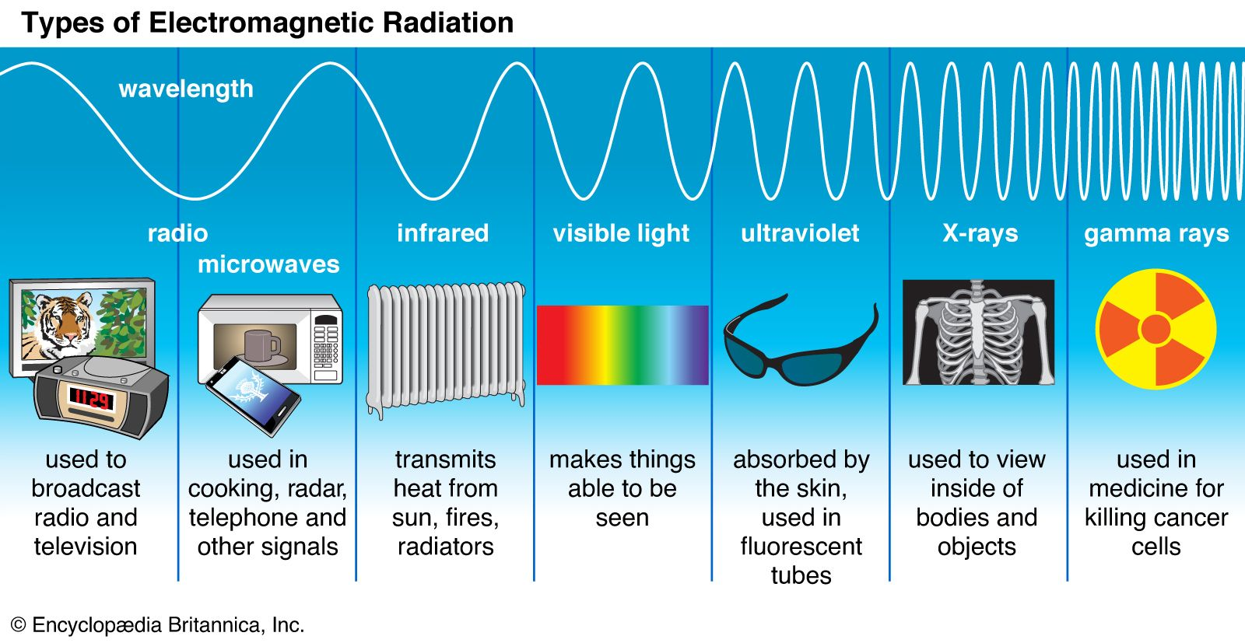
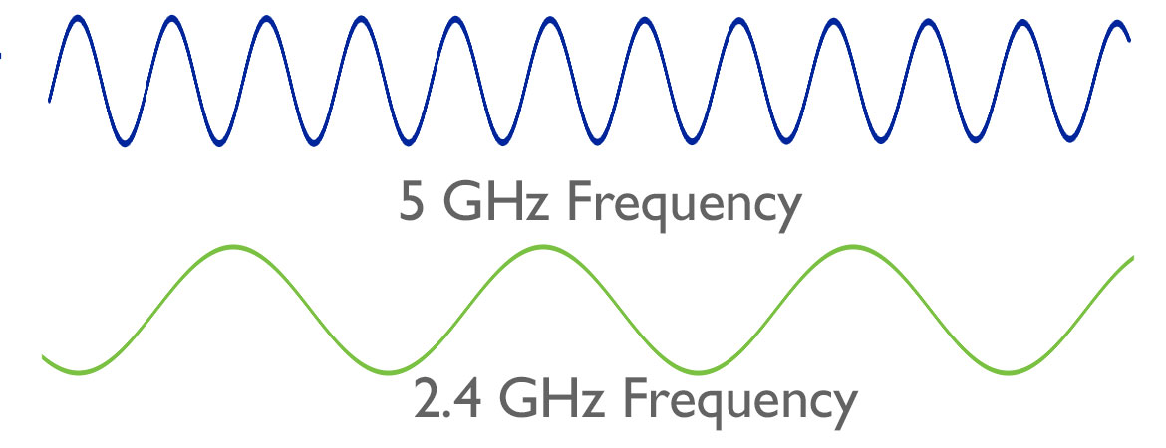
Wireless Networks
Transmission Medium = waves in the air
We can transmit waves at different frequencies

Slide 5
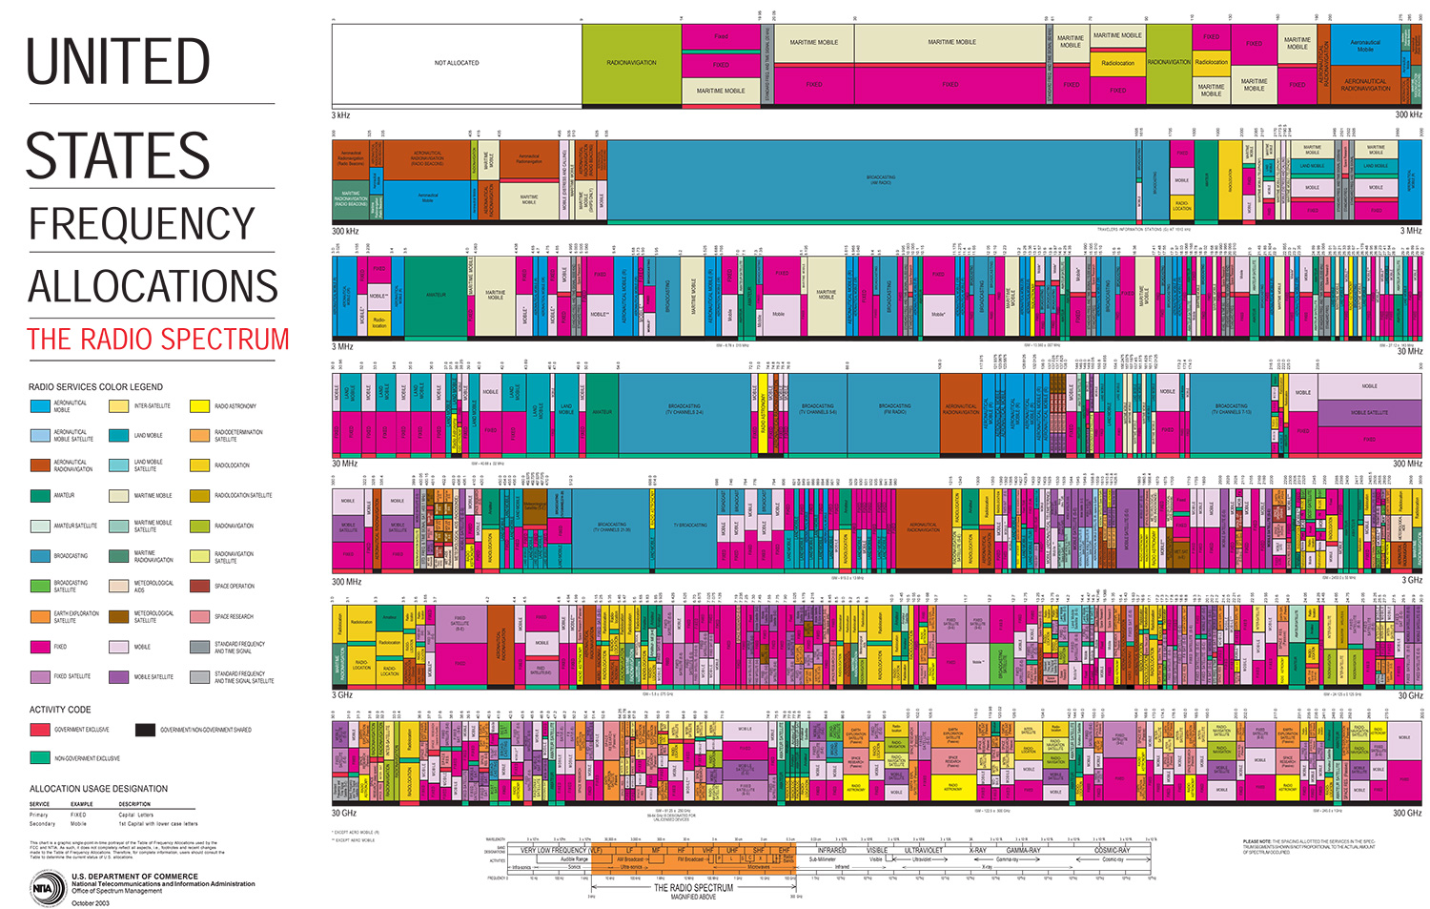
AM radio
TV
TV
TV
TV
TV
Cellular
WIFI
WIFI
The government controls which frequencies should be used for different technologies/services

Slide 6
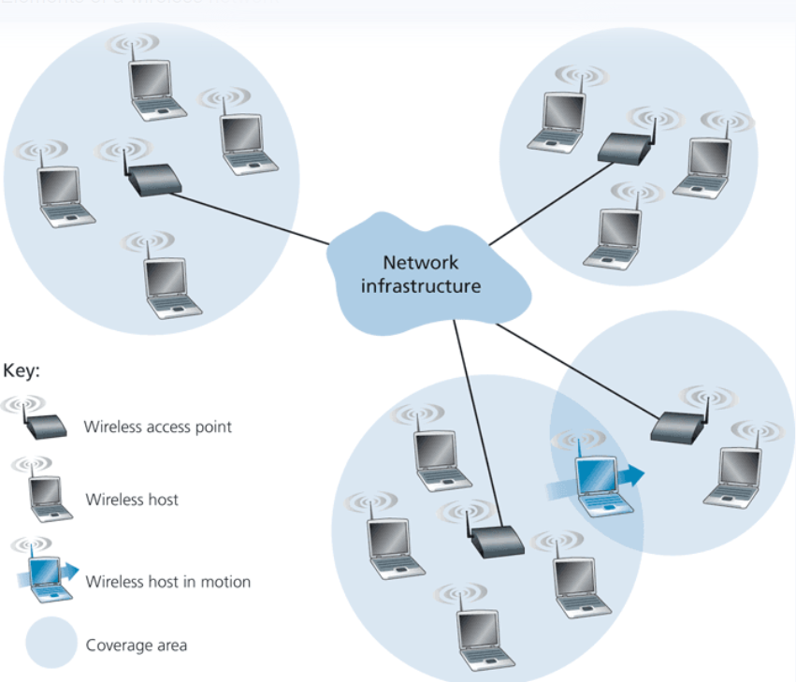
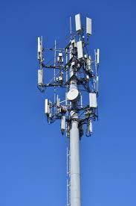
Anatomy of a Wireless Network
Wireless networks are an extension of the standard internet, and usually only occur at the network edge
Wireless hosts are devices that require a wireless connection (laptop, cell phone, IoT, Bluetooth)
This can be mobile, or stationary
(Wired)
Wireless hosts connect to a wireless access point that will connect them to the greater internet. Typically linked to a geographic location
Cell towers are the access points in cellular networks
If you are not in range of a wireless access point, you will not be able to connect to the internet

Slide 7
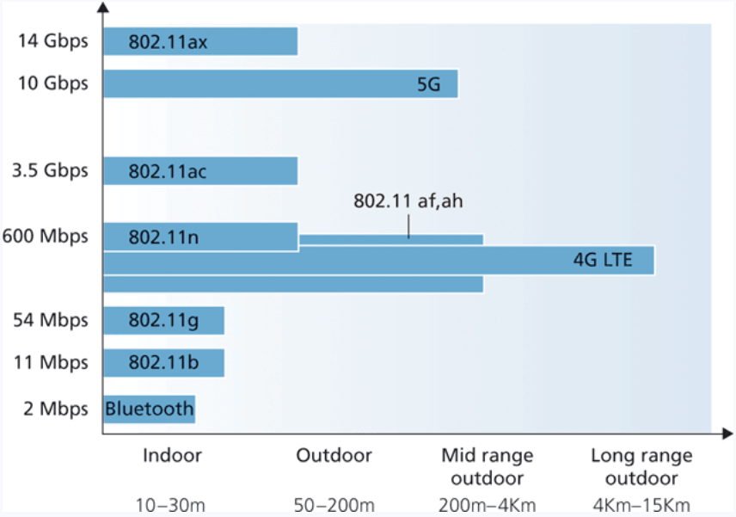
Wireless Network Tradeoffs
In wireless networks, we see a tradeoff between throughput, and effective range
Easer to create high bandwidth links over high frequency carriers, but higher frequencies lose energy more rapidly and it propagates
Generally, lower frequencies are better for long distance communication
802.11 = WiFi

Slide 8
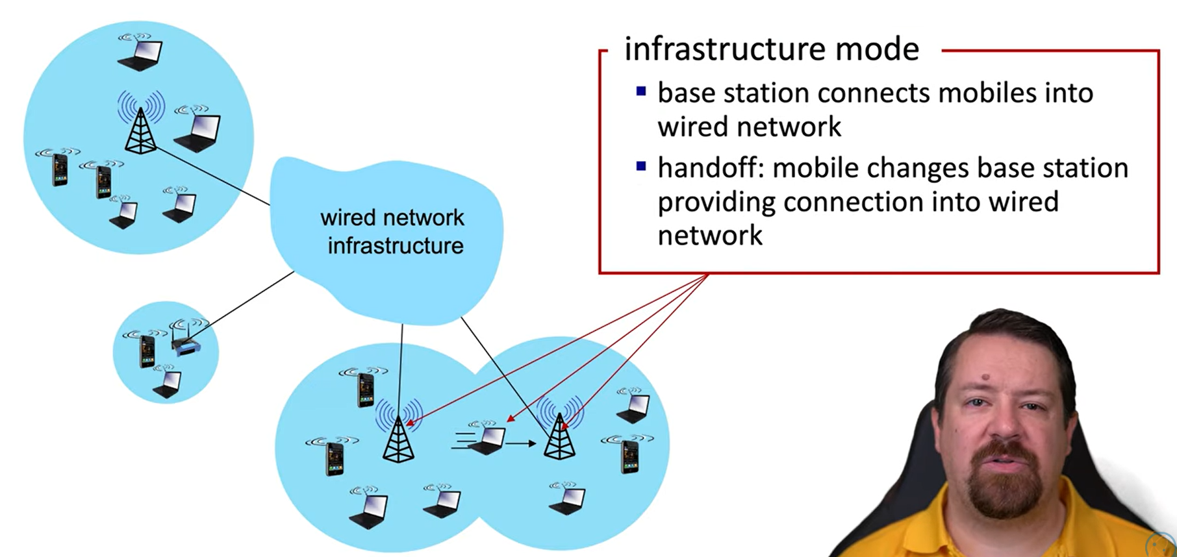
Wireless Network Tradeoffs

Slide 9
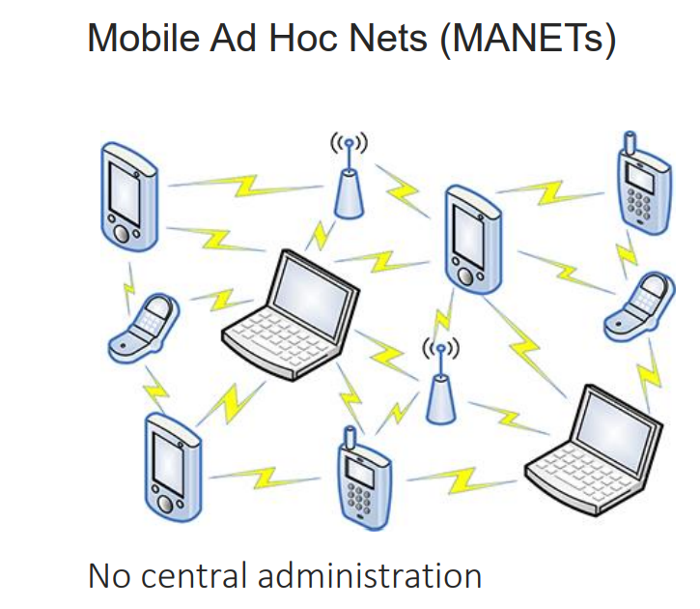
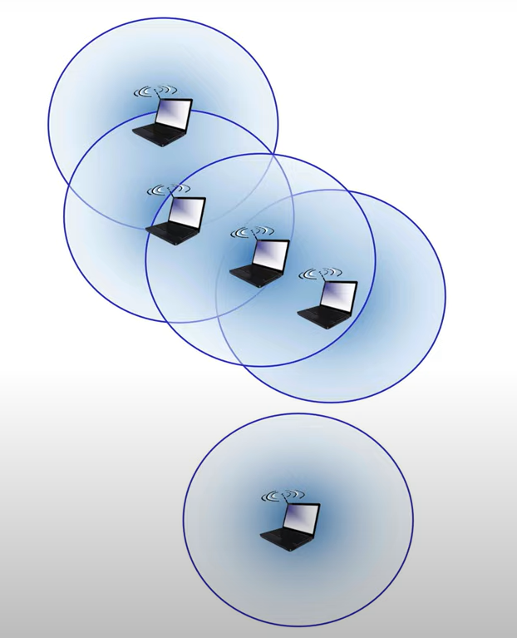
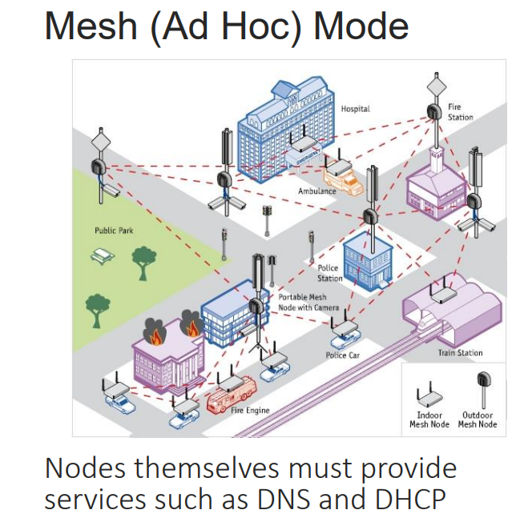
Wireless Network Structure
Ad hoc mode
No base stations
Nodes can only transmit to other nodes within link coverage
Nodes organize themselves into a network: route amongst themselves
This is advantageous where infrastructure may be damaged or not available

Slide 10
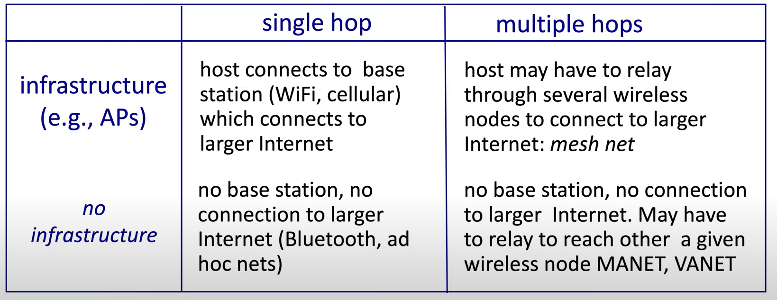
Wireless Network Taxonomy
(ad hoc)

Slide 11
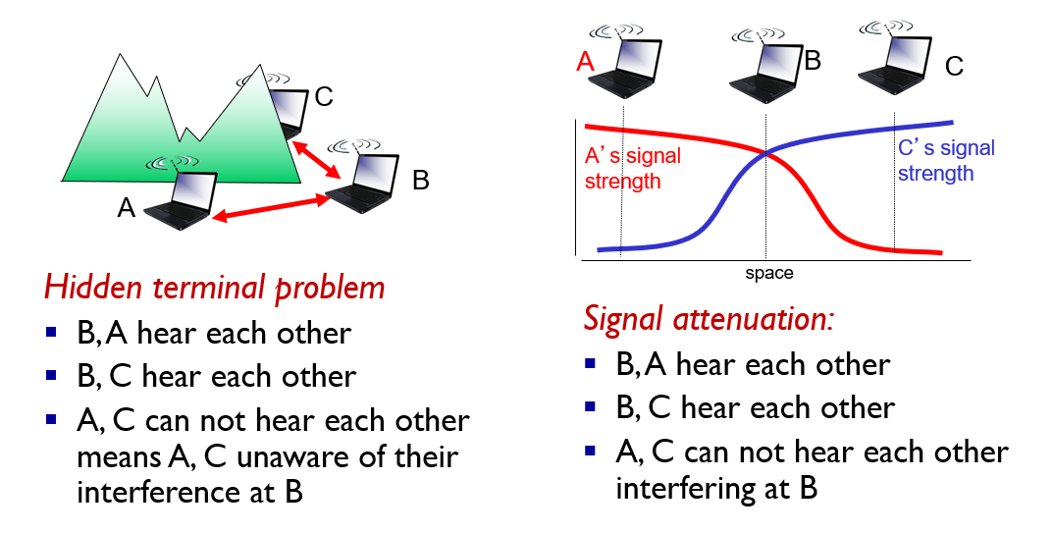
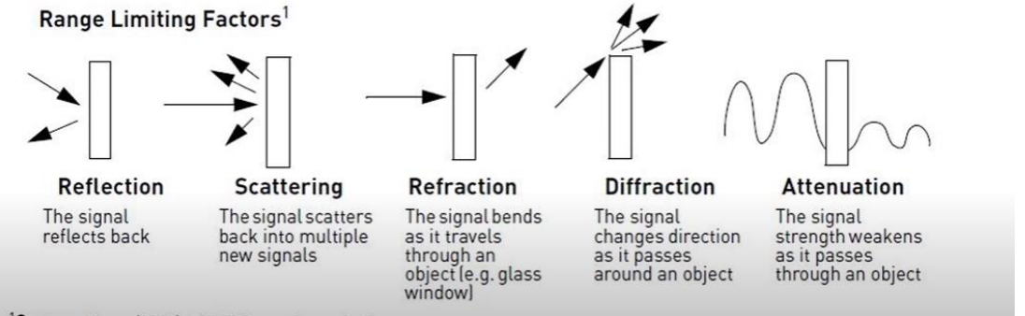
Wireless Link Characteristics
Important differences from wired link…
Decreased signal strength: radio signal attenuates as it propagates through matter (path loss)
Interference from other sources: wireless network frequencies (such as 2.4 ghz) shared by many devices will cause interferences
Multipath propagation: radio signal reflects off objects ground, arriving at destination at slightly different speeds
This makes wireless link communication much more challenging, compared to wired links

Slide 12
Wireless Link Characteristics
Wireless links have a threshold value they must operate over
→ If the wireless link does not meet this threshold, then a receiver cannot extract signal
10⁻¹
SNR: signal-to-noise ratio
Larger SNR – easier to extract signal from noise (good thing)
BER: Bit Error Rate
→ Large BER – data is corrupted more frequently
10⁻²
10⁻³
BER
10⁻⁴
10⁻⁵
SNR vs BER tradeoff
Given physical layer: increase power → increase SNR → decrease BER
Given SNR: choose physical layer that meets BER requirement, giving highest throughput
10⁻⁶
10⁻⁷
10
20
30
40
SNR(dB)
QAM256 (8 Mbps)
Some BER is acceptable… remember that we do always have error checking happening at link layer/transport layer
QAM16 (4 Mbps)
BPSK (1 Mbps)

Slide 13
Shared Broadcast
Because wireless networks are sharing a medium/frequency, we need mechanisms for sharing bandwidth so that collisions don’t occur
In the link layer we have three types
1. TDMA (Time division Multiple Access)
2. FDMA (Frequency Division Multiple Access)
3. CDMA (Code Division Multiple Access)
Wired Networks
Wireless Networks

Slide 14
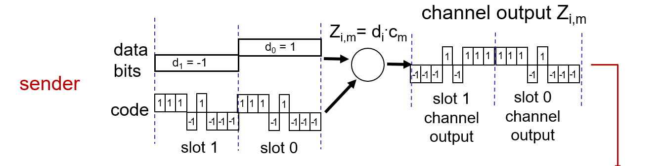
CDMA (Code Division Multiple Access)
All users transmit on the same frequency, but are assigned a unique code (chipping sequence)
In a CDMA protocol, each bit being sent is encoded by multiplying the bit by a signal (the code)
Encoding: inner product: (original data) * (chipping sequence)
Decoding: summed inner-product: (encoded data) * (chipping sequence)

Slide 15
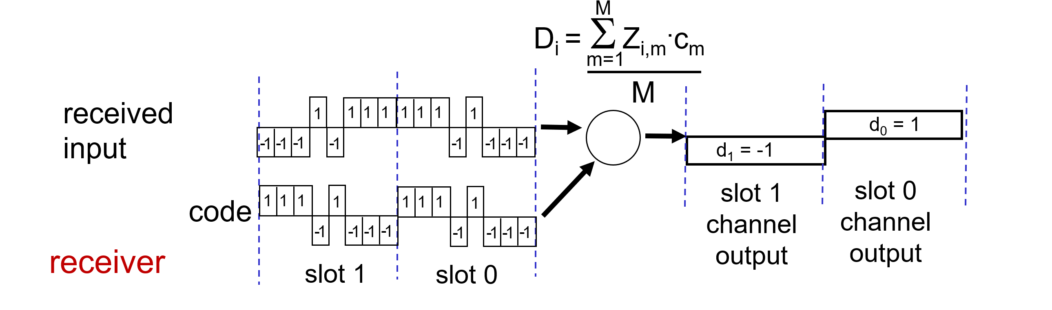

CDMA (Code Division Multiple Access)

Slide 16
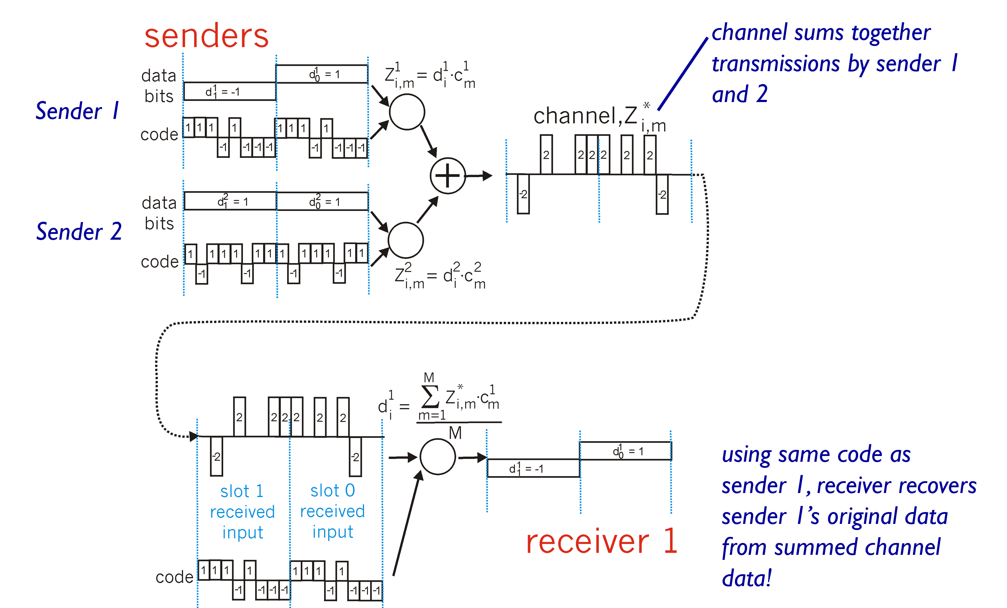
CDMA (Code Division Multiple Access)

Slide 17
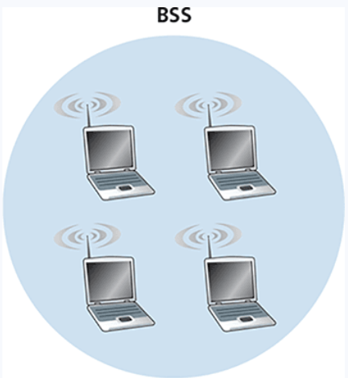
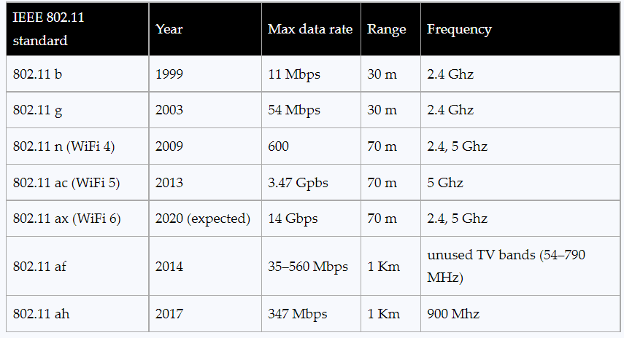
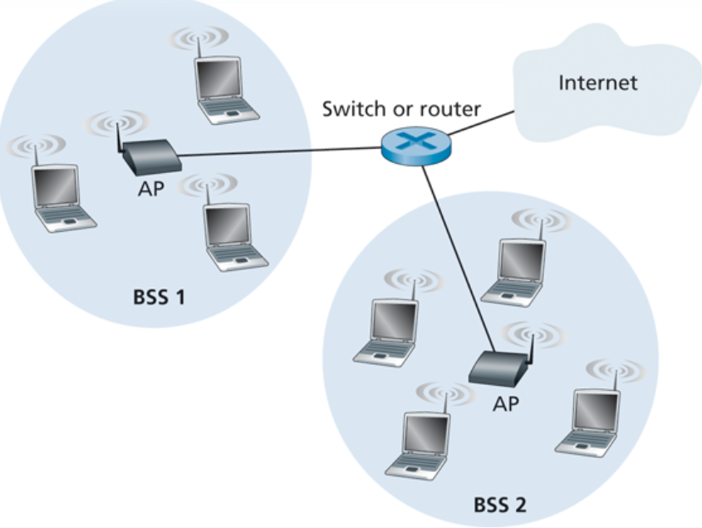
802.11 (Wifi) (Wireless LANs)
We could also have an 802.11 ad hoc network
802.11 architecture consists of a basic service set (BSS). A BSS contains one or more wireless stations and an access point
Identified by Service Set Identifier (SSID)

Slide 18
802.11 (Wifi) (Wireless LANs)
802.11b: 2.4GHz-2.485GHz spectrum divided into 11 channels at different frequencies
AP admin chooses frequency for AP
interference possible: channel can be same as that chosen by neighboring AP!
host: must associate with an AP
scans channels, listening for beacon frames containing AP’s name (SSID) and MAC address
selects AP to associate with
may perform authentication [Chapter 8]
will typically run DHCP to get IP address in AP’s subnet

Slide 19
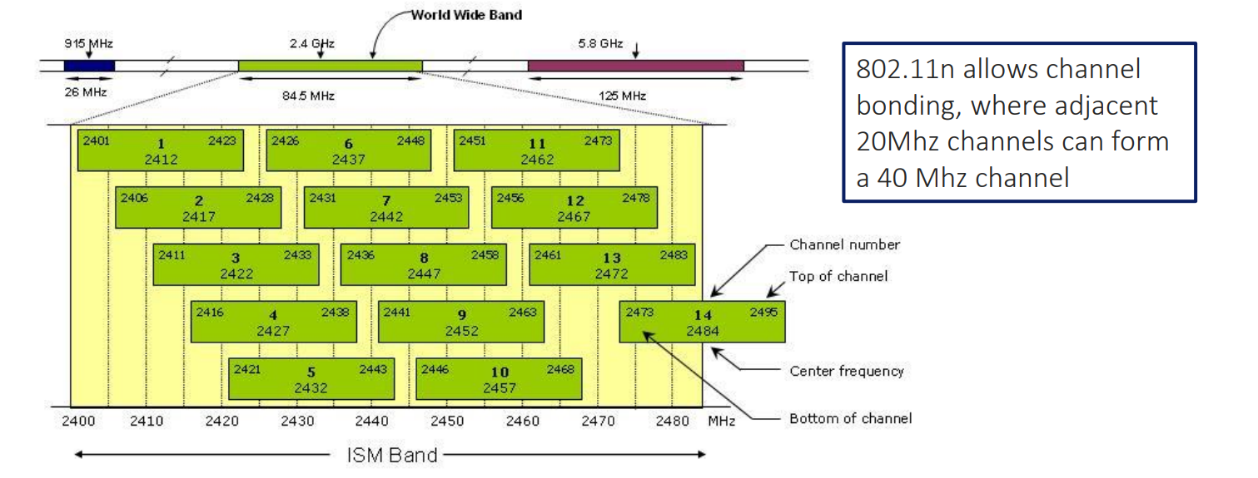
802.11 (Wifi) (Wireless LANs)

Slide 20
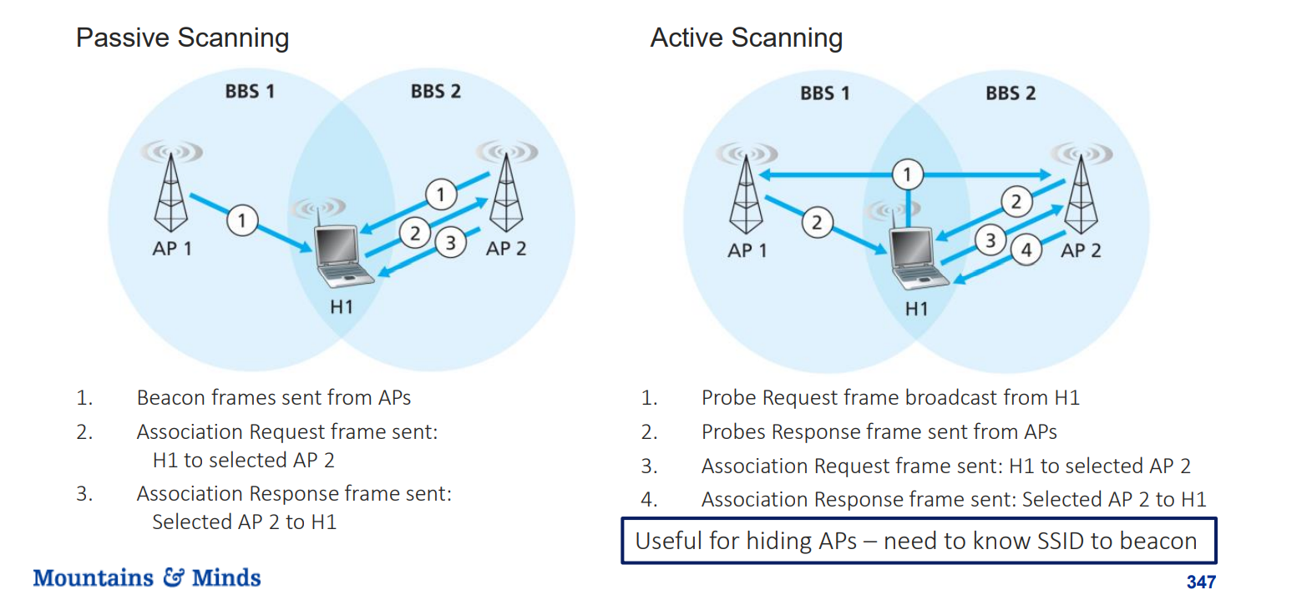
Establishing Connectivity
New devices will be allowed to join the network typically after authentication (password, username/password, MAC address, Captcha)

Slide 21
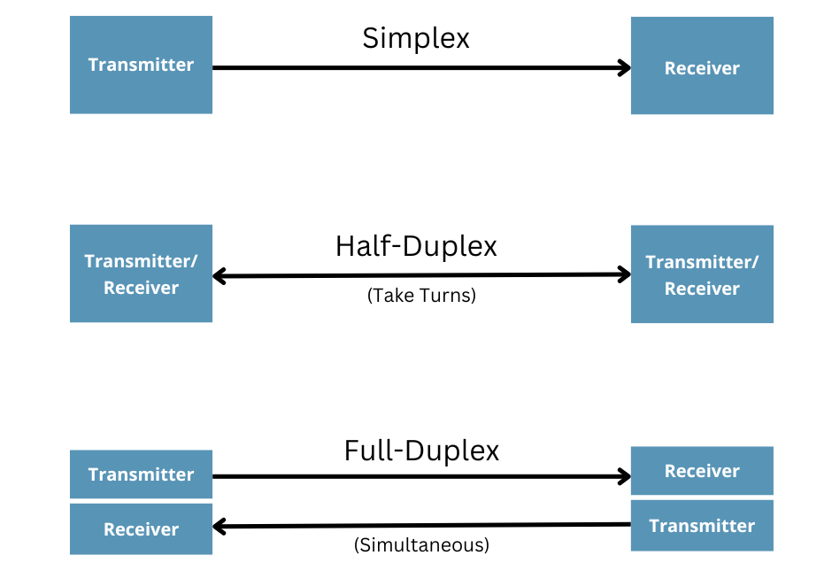
Collision Detection/Avoidance in 802.11
In (wired) ethernet, we had MAC protocols that would listen on a channel, and only transmit if the channel was empty
→ Requires the ability to listen and transmit at the same time (full-duplex)
When WiFi begins to transmit a frame, it transmits the frame in its entirety; there is no going back
WiFi is not full-duplex, which means it cannot detect collisions, so we must avoid collisions instead

Slide 22
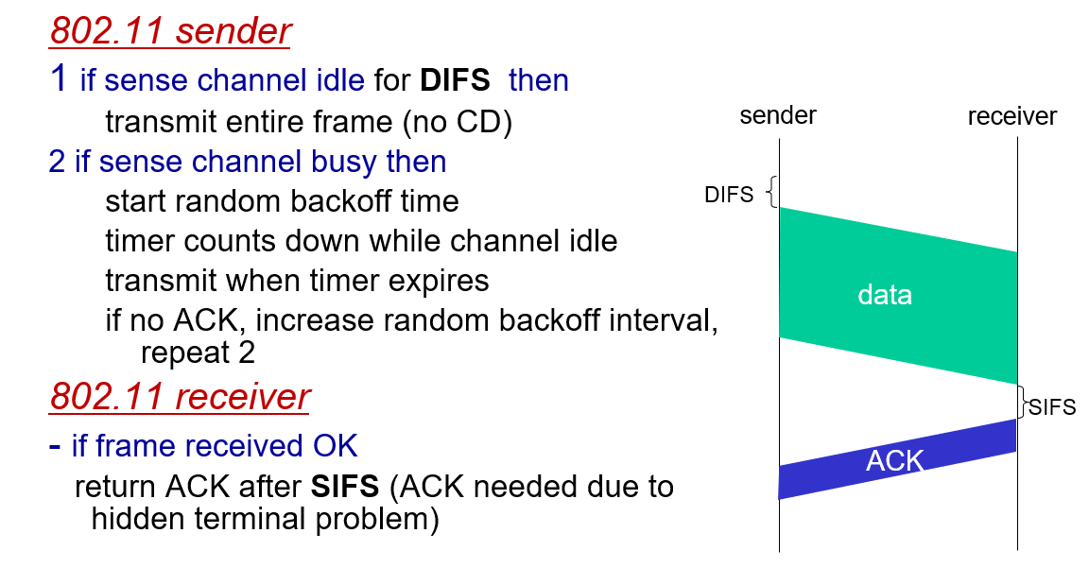
Collision Detection/Avoidance in 802.11
WiFi is not full-duplex, which means it cannot detect collisions, so we must avoid collisions instead
WiFi uses Carrier-Sense Multiple Access with Collision Avoidance (CSMA/CA)
Introduces ACKs at a link-layer level
Distributed Inter-frame Space (DIFS)
Short Inter-frame Spacing (SIFS)

Slide 23
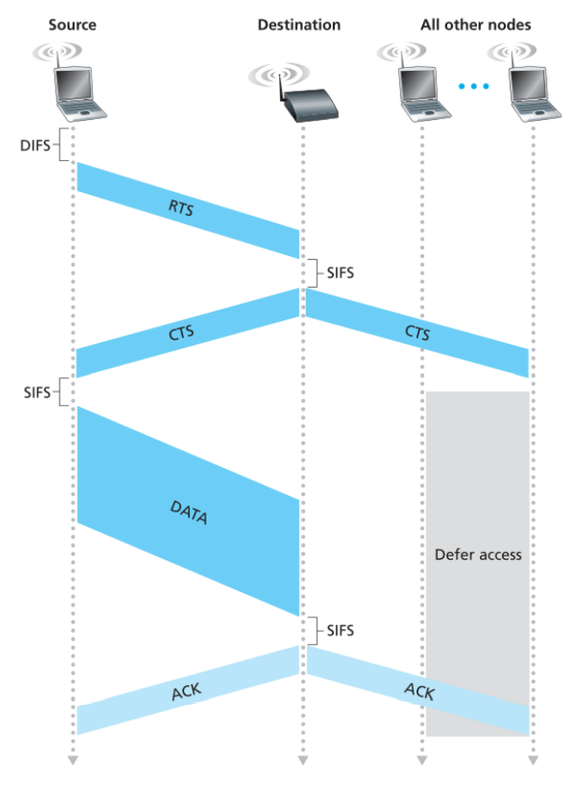
Collision Detection/Avoidance in 802.11
WiFi is not full-duplex, which means it cannot detect collisions, so we must avoid collisions instead
The sender first transmits a request to send (rts) frame
WiFi uses Carrier-Sense Multiple Access with Collision Avoidance (CSMA/CA)
If the AP is free, then it will send back a clear to send (cts) packet
The AP denies access to all other nodes until the AP sends an ACK
Main Idea: Ask for permission, and reserve channel before transmitting data
All other nodes get the CTS/ACK, but they ignore it

Slide 24
Collision Detection/Avoidance in 802.11
WiFi is not full-duplex, which means it cannot detect collisions, so we must avoid collisions instead
The sender first transmits a request to send (rts) frame
WiFi uses Carrier-Sense Multiple Access with Collision Avoidance (CSMA/CA)
If the AP is free, then it will send back a clear to send (cts) packet
https://wps.pearsoned.com/ecs_kurose_compnetw_6/216/55463/14198702.cw/index.html
The AP denies access to all other nodes until the AP sends an ACK
Main Idea: Ask for permission, and reserve channel before transmitting data
All other nodes get the CTS/ACK, but they ignore it

Slide 25
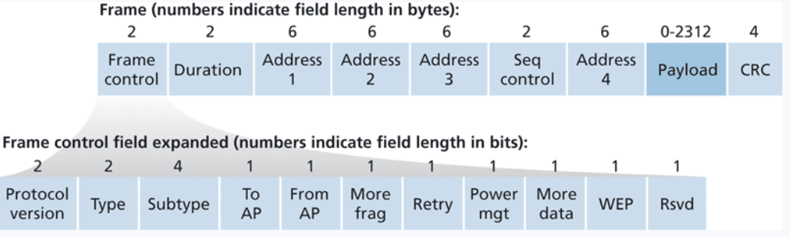
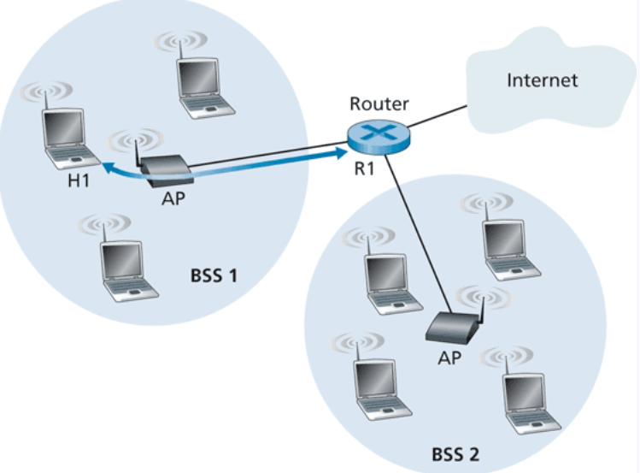
WiFi Frame
A WiFi frame can fit four 6-byte MAC addresses
We need the MAC address of the source host, destination host, and the AP
Once the AP gets the WiFi frame, it can convert it to a ethernet frame and send it through the main internet

Slide 26
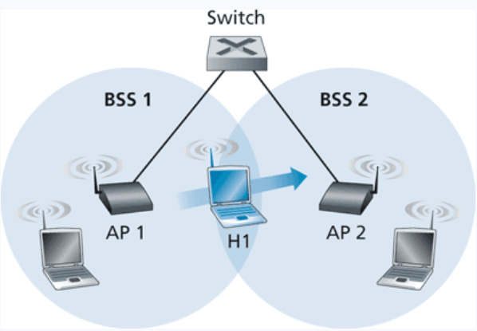
WiFi Mobility
If a device is moving, it may be moving in and out of WiFi networks
Need to handle routing and IP addressing
What to do when a device switches networks in the middle of a TCP stream, for example?
→ Send an ethernet frame from old network to new network and update routing tables if needed

